Slide 1
HOW WE SURVIVED LOCKDOWN
Parramatta Hills Members’ Meeting 24 September 2021

Slide 2
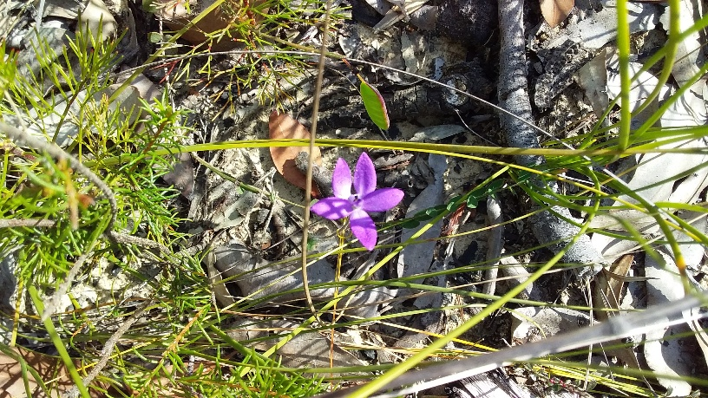
Marilyn went walking in Marramarra National Park
Glossodia minor

Slide 3
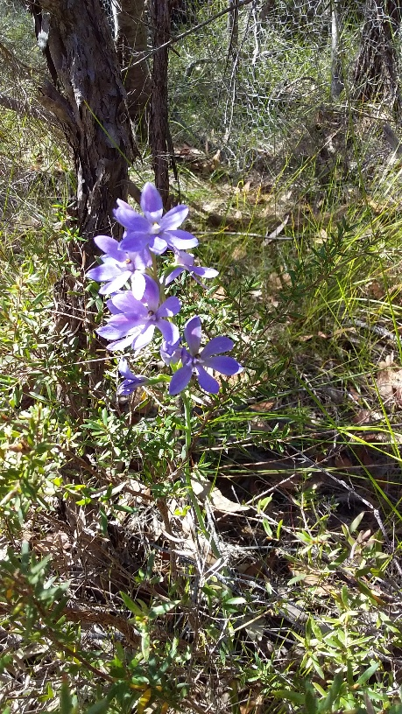
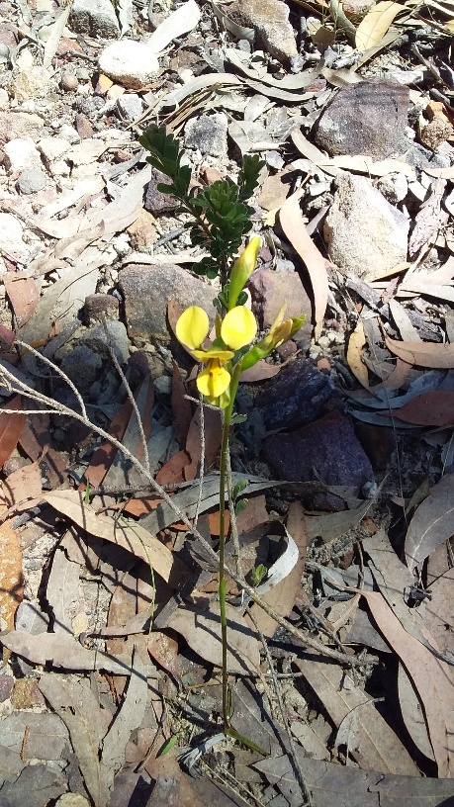
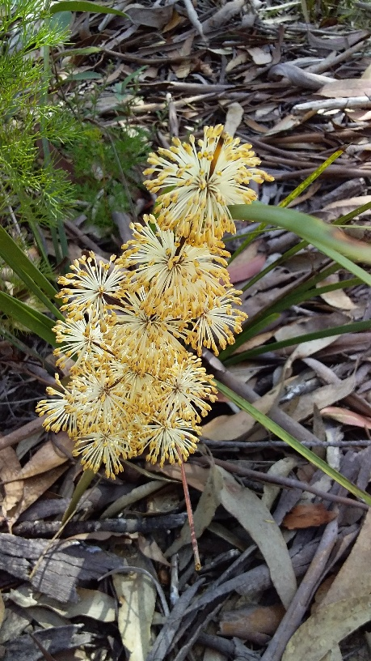
Thelmitra media
Diuris aurea
Lomandra obliqua

Slide 4
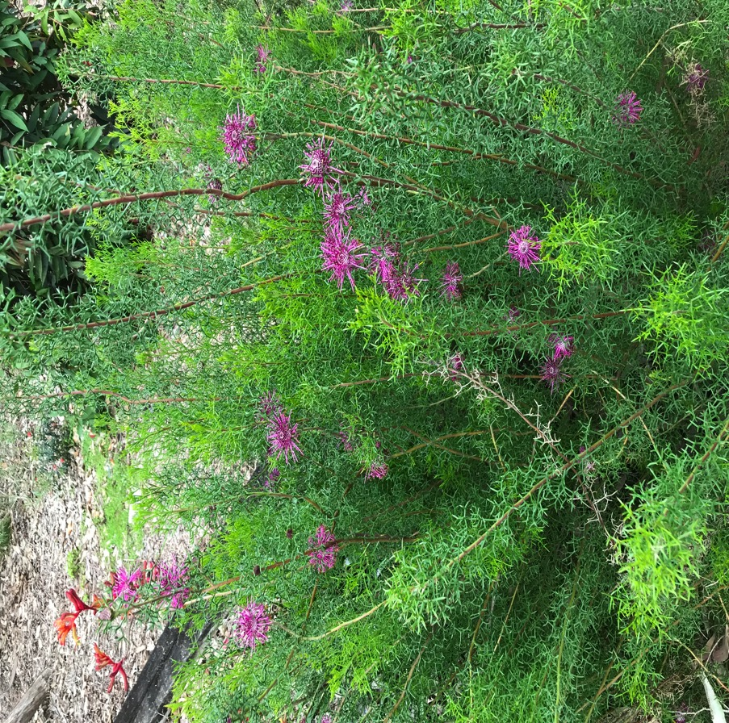
Jeff’s Garden
Isopogon formosus

Slide 5
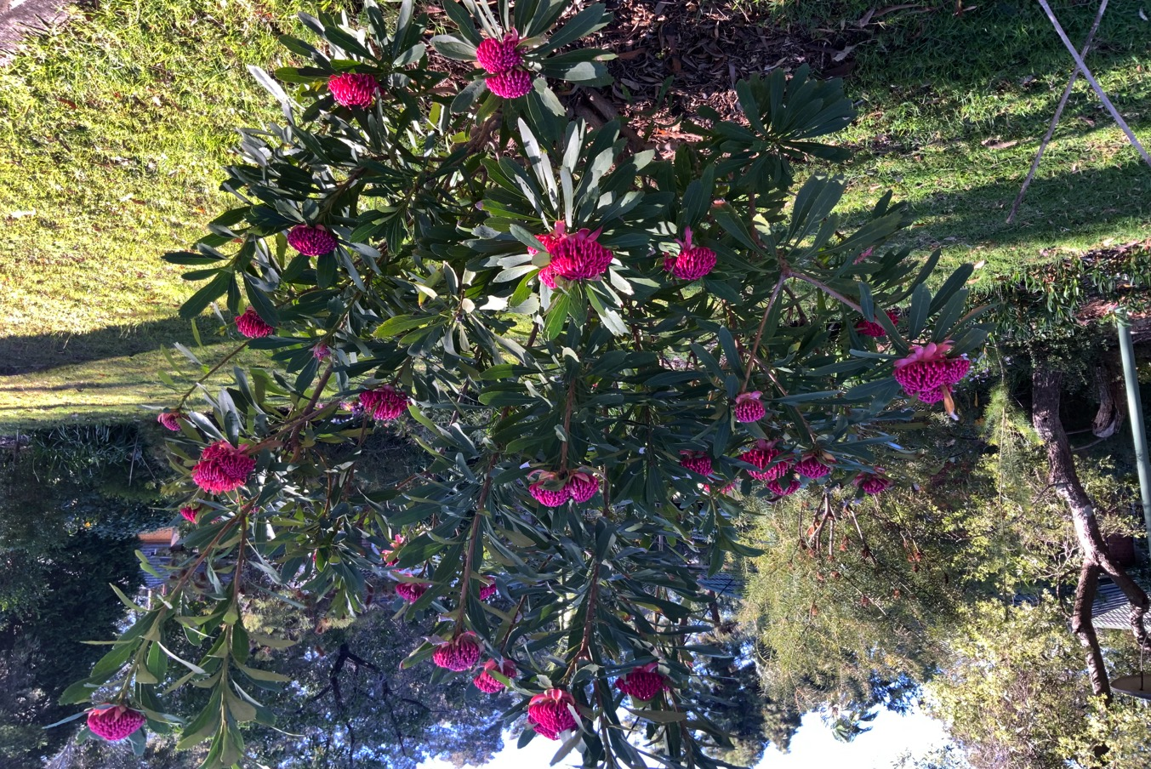
A Waratah Sensation in Oatlands

Slide 6
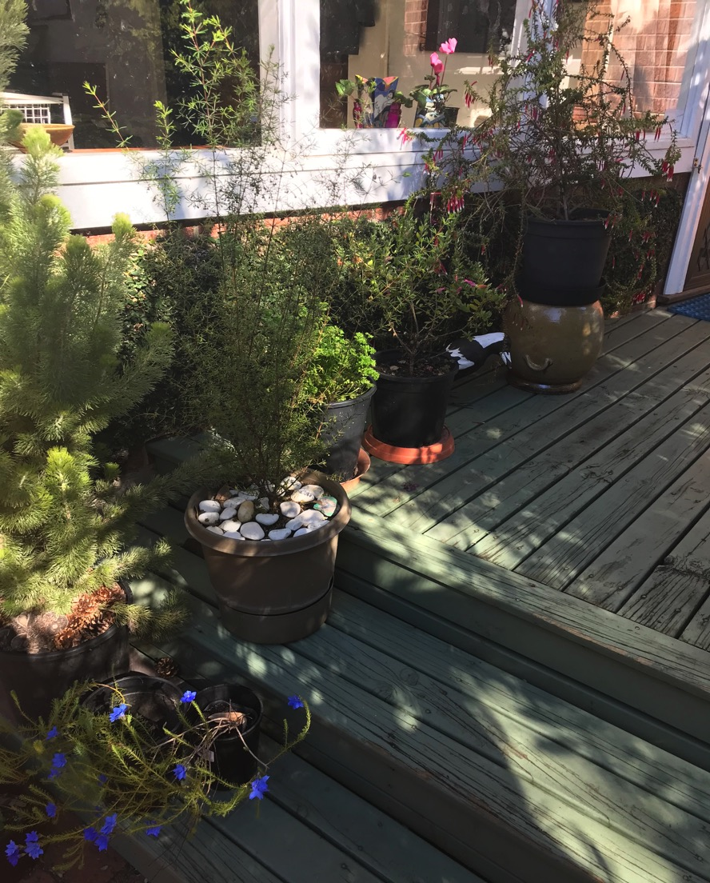
Success! Boronia megastigma The secret is to grow in a pot and a saucer of water

Slide 7
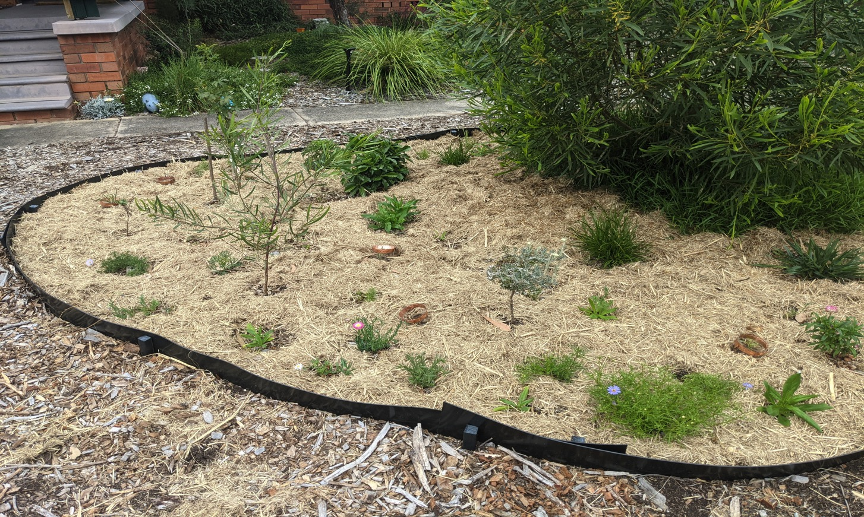
Jessica planted a new Garden

Slide 8
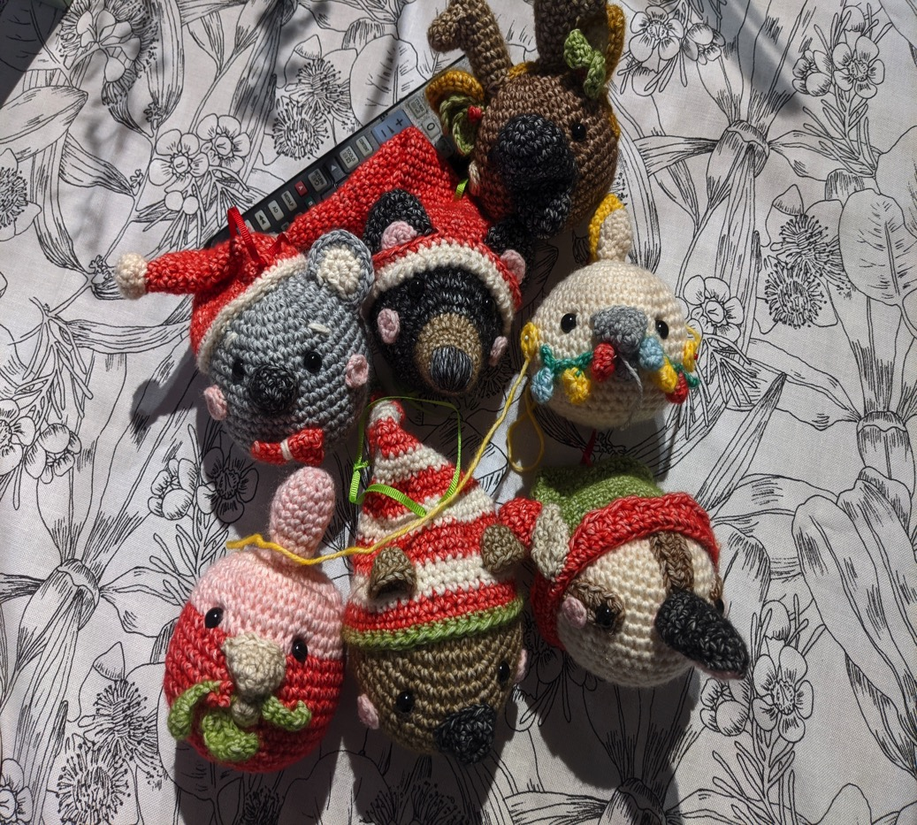
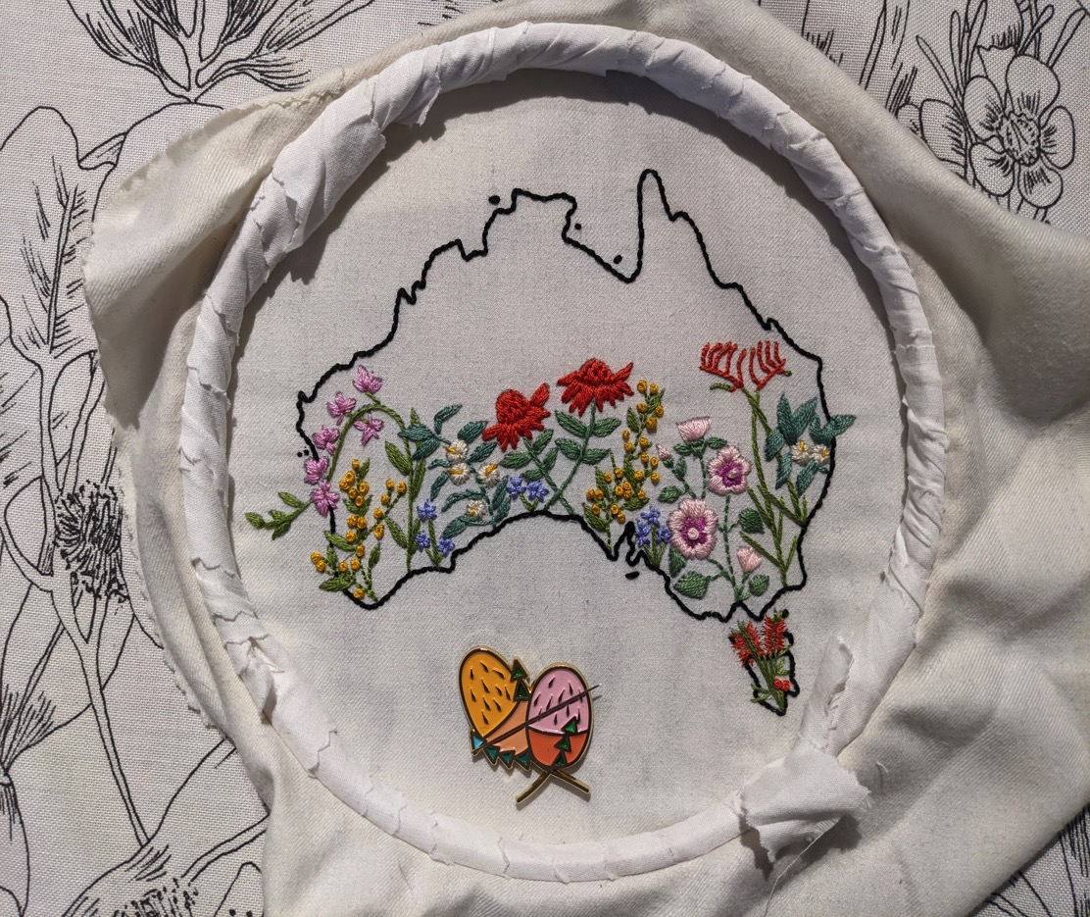
And Got Crafty

Slide 9
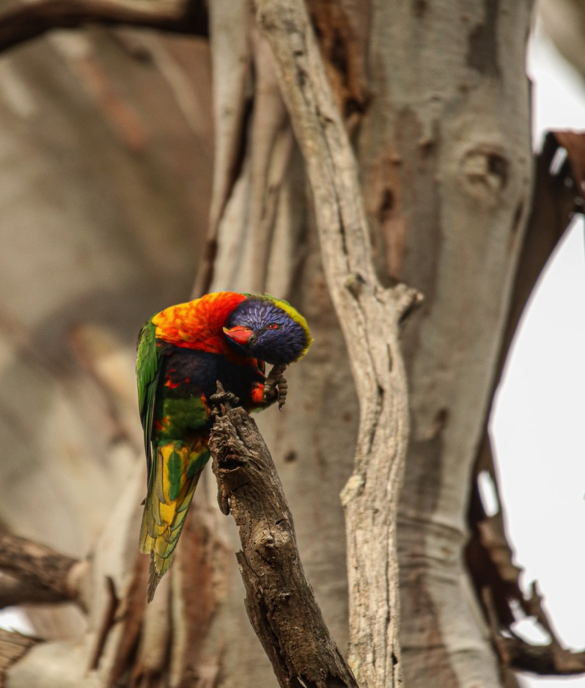
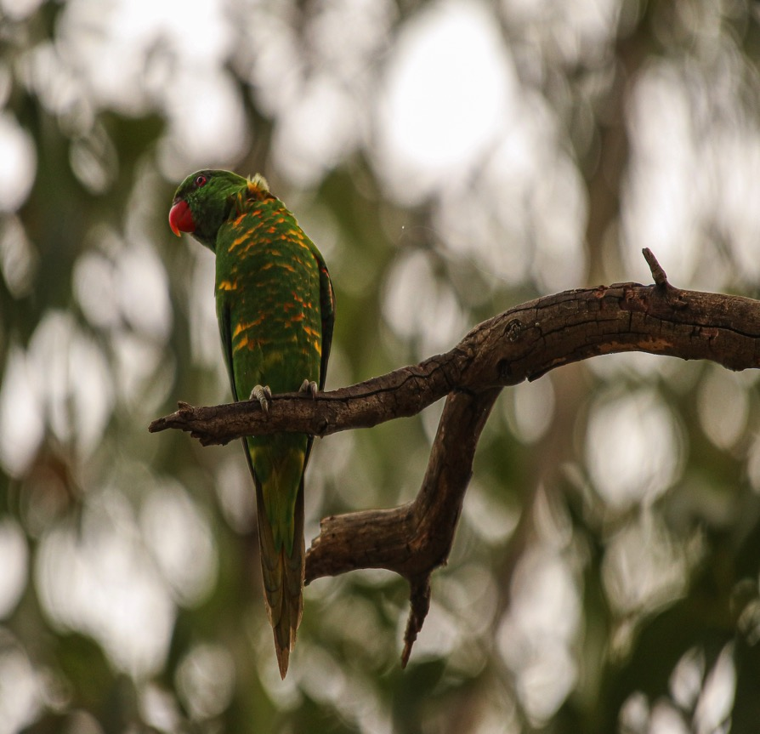
Jessica and Wayne went Birdwatching along Toongabbie Creek Scaly breasted Lorikeet and Rainbow Lorikeet

Slide 10
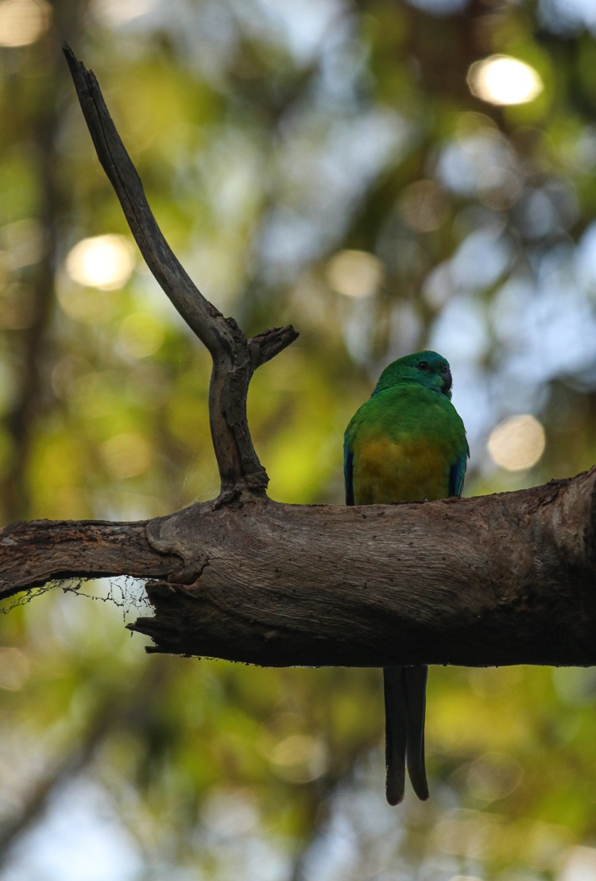
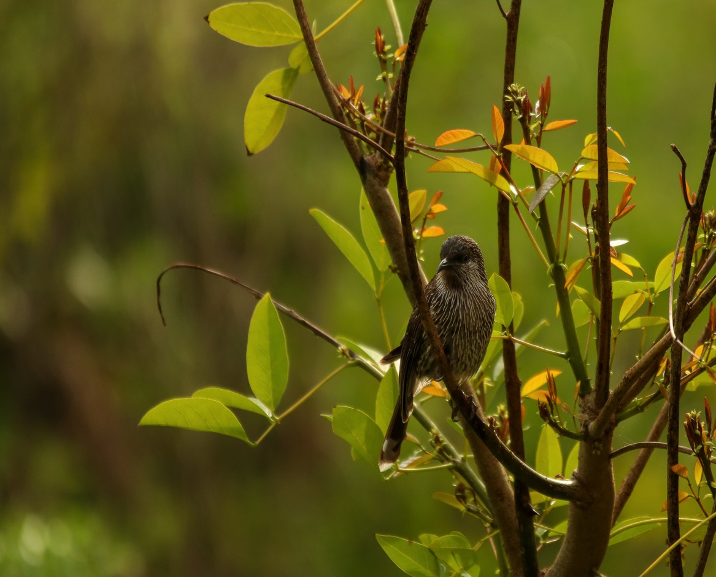
Red Rumped Parrot and Little Wattle Bird Toongabbie Creek

Slide 11
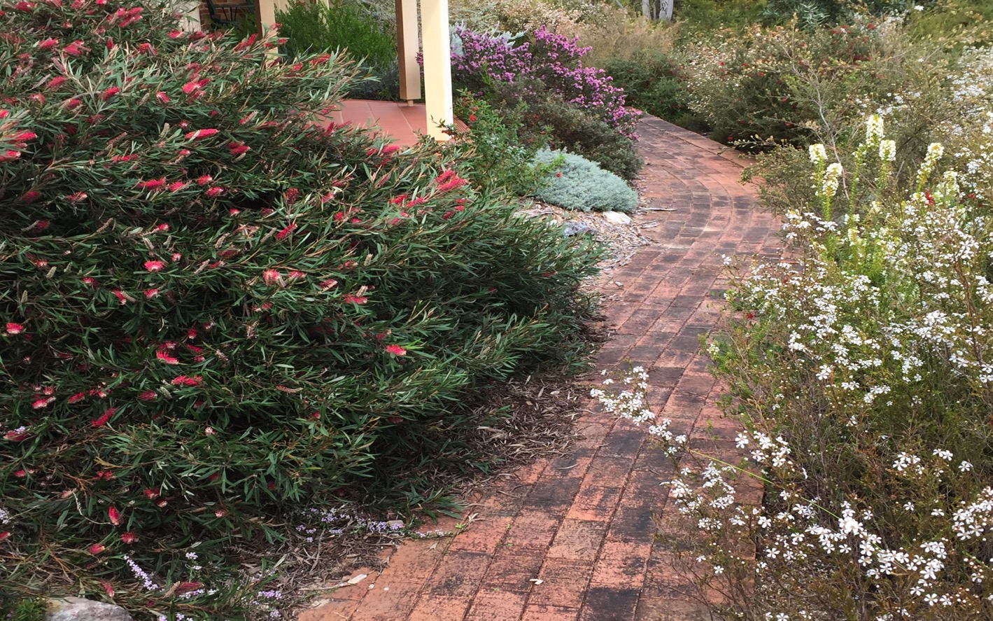
Ian Kept Gardening Left hand side is cultivated garden. On the right is natural bush regenerated after fire.

Slide 12
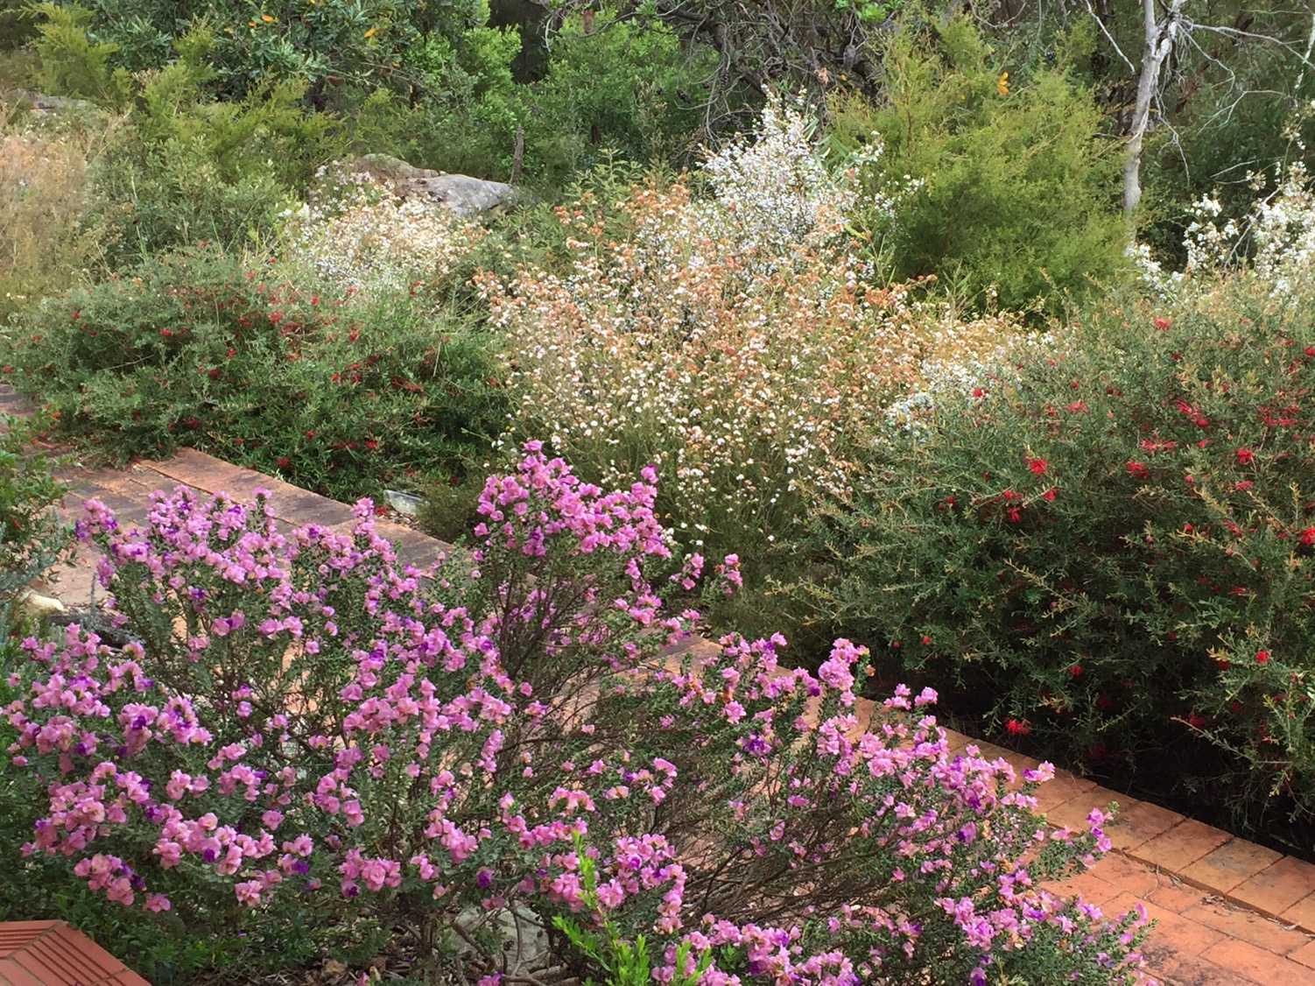

Slide 13
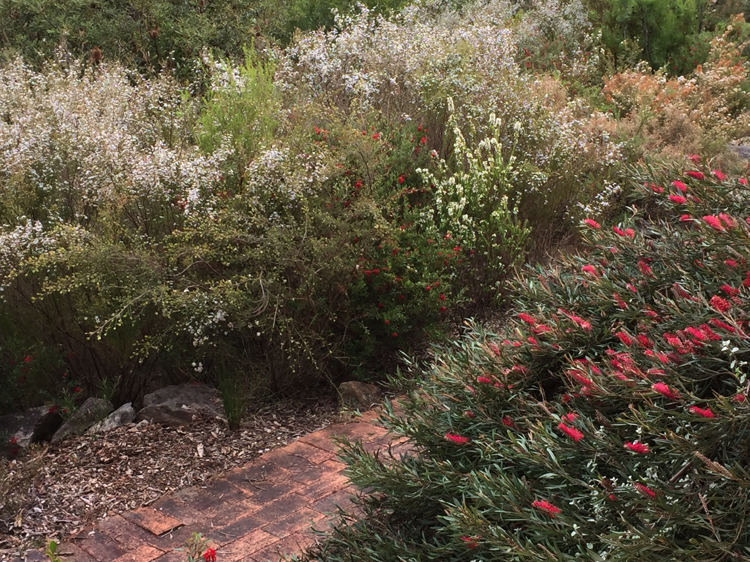

Slide 14
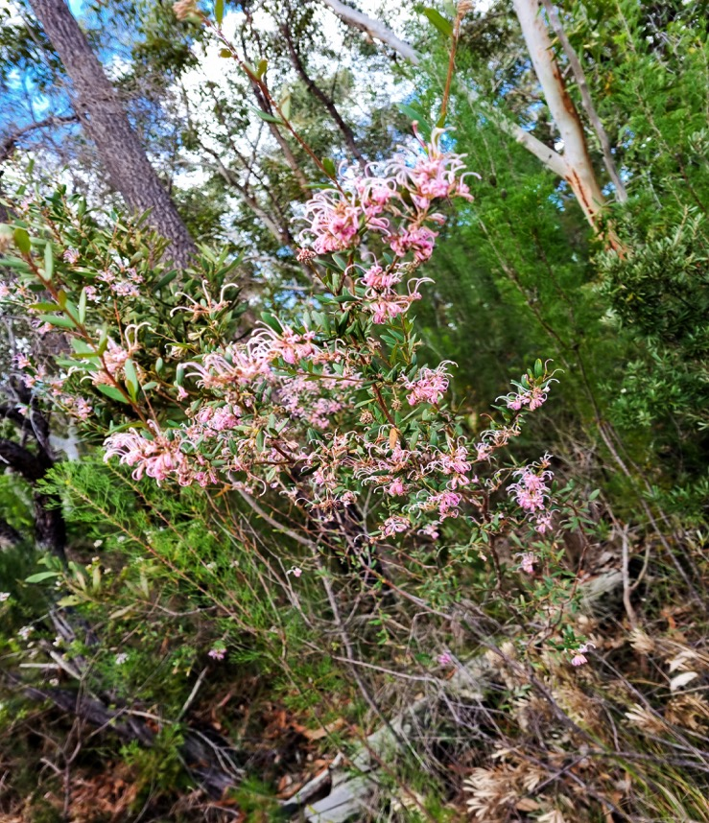
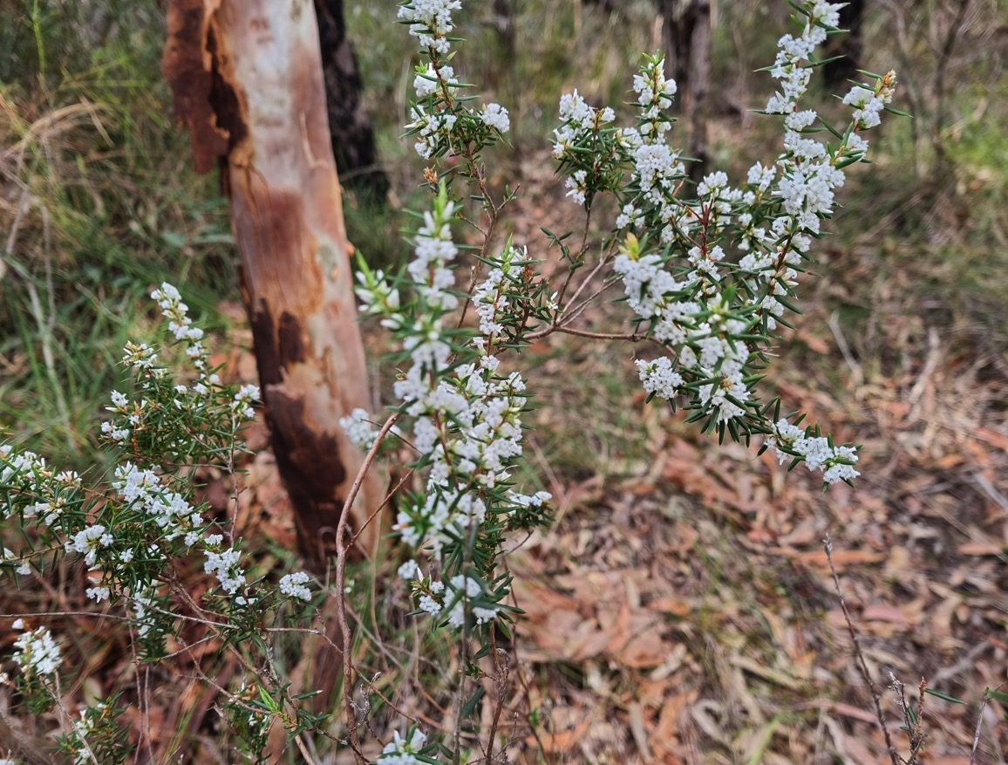
Pip and Jennifer Revisited the Refuge Rock Walk at Cherrybrook
Grevillea sericea
Leucopogon ericoides

Slide 15
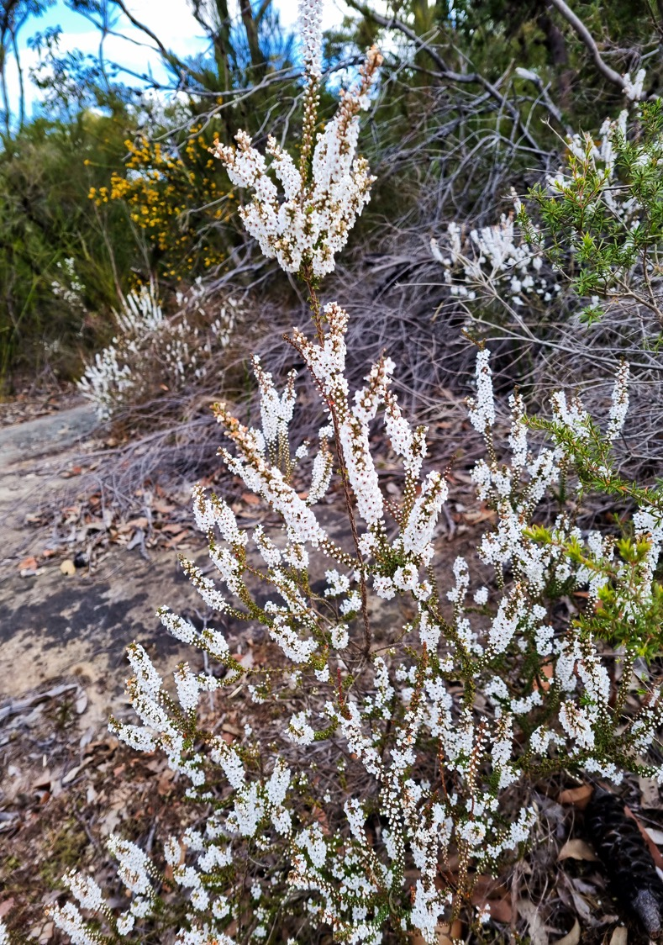
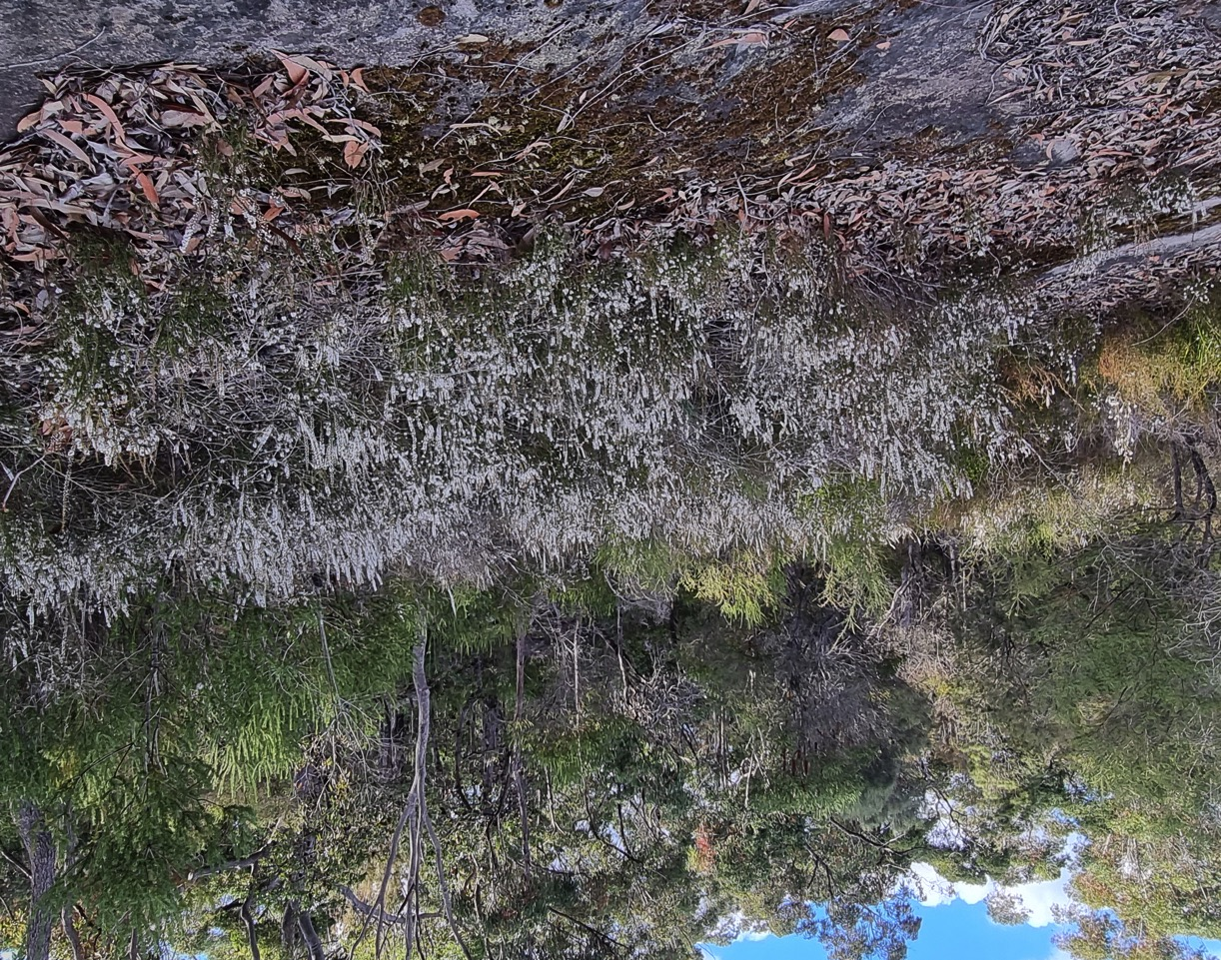
The rock covered in Epacris microphylla and Leucopogon

Slide 16
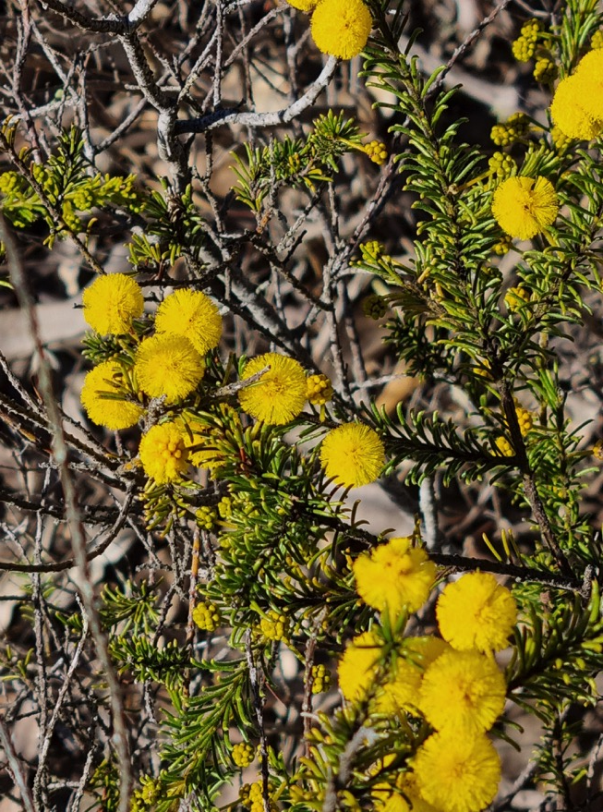
And Neich Road to find Acacia gordonii flourishing

Slide 17
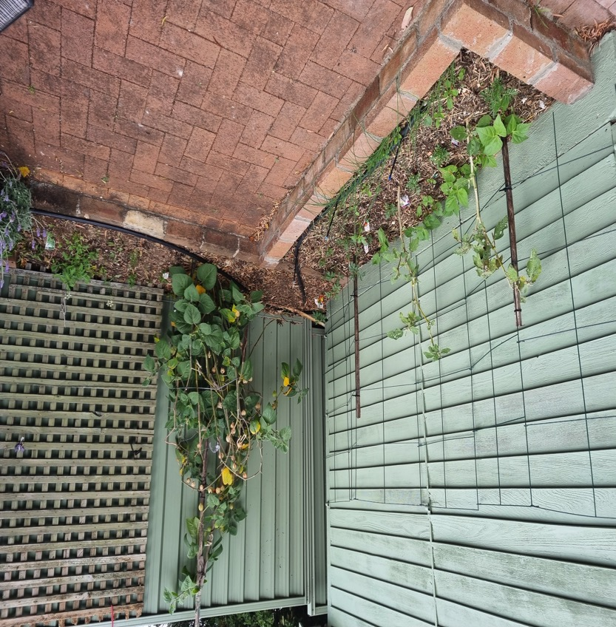
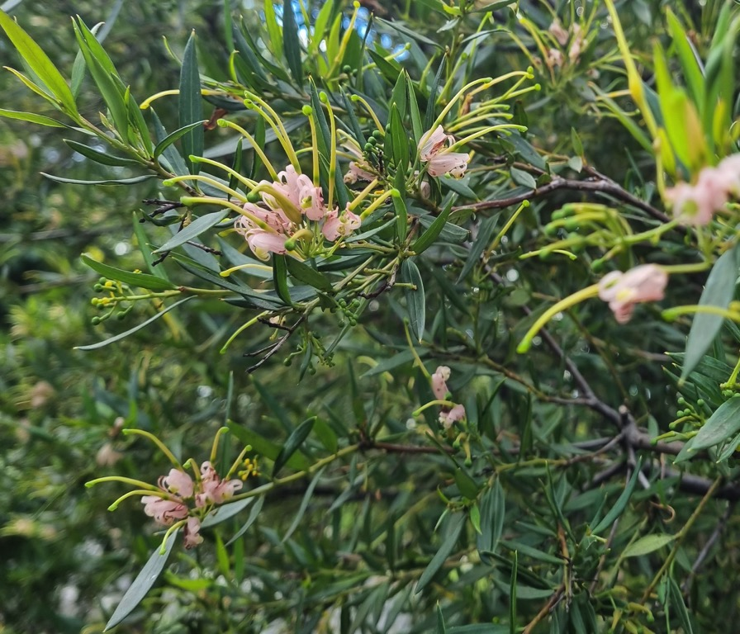
Jennifer Pruned and created a new Vegetable Garden

Slide 18
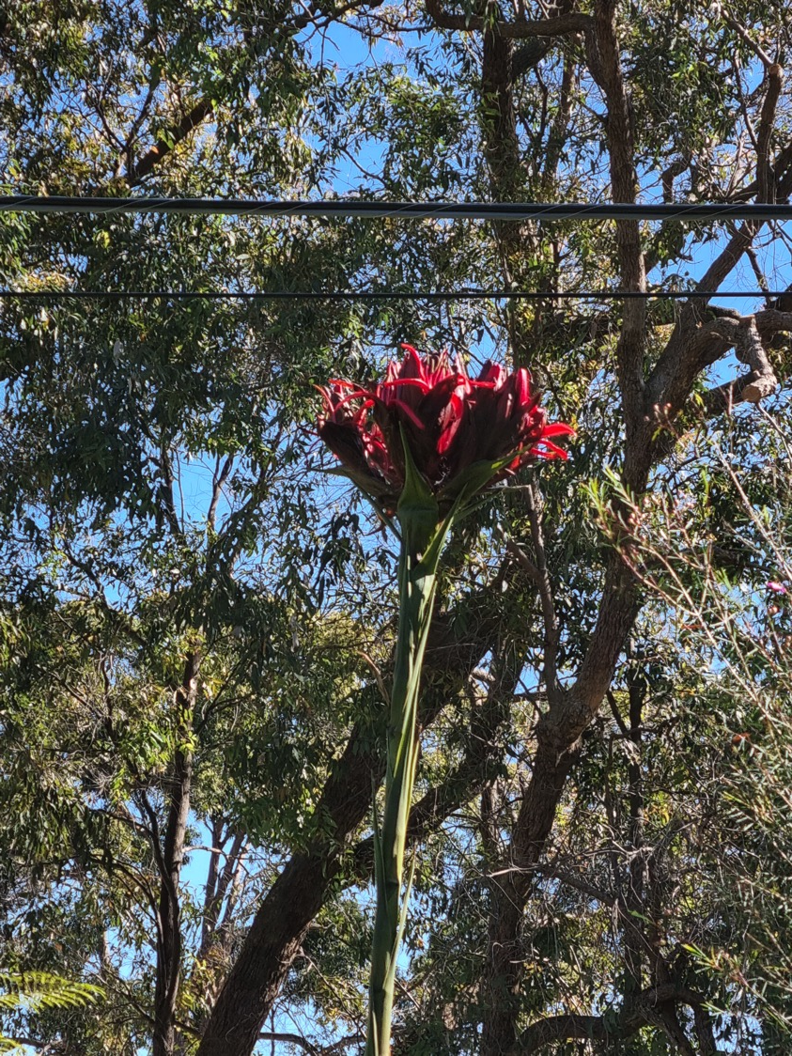
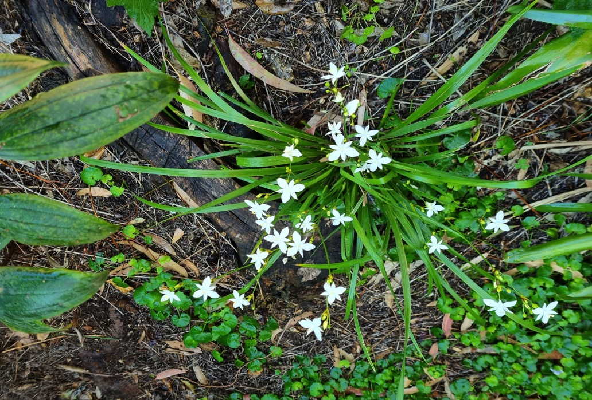
Two plants flowering for the first time
Gymea Lily Doryanthes excelsa
Libertia paniculata

Slide 19
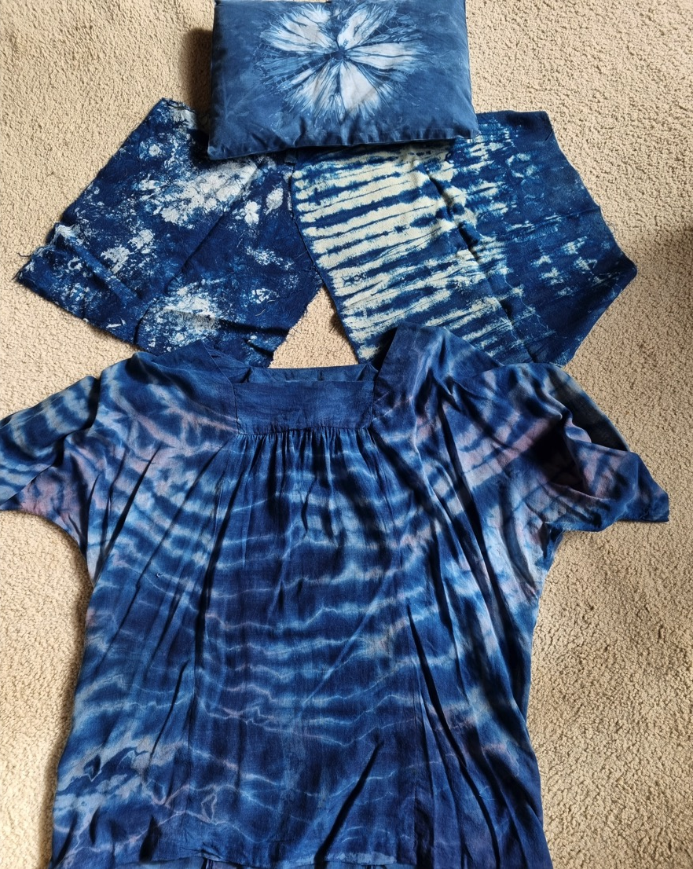
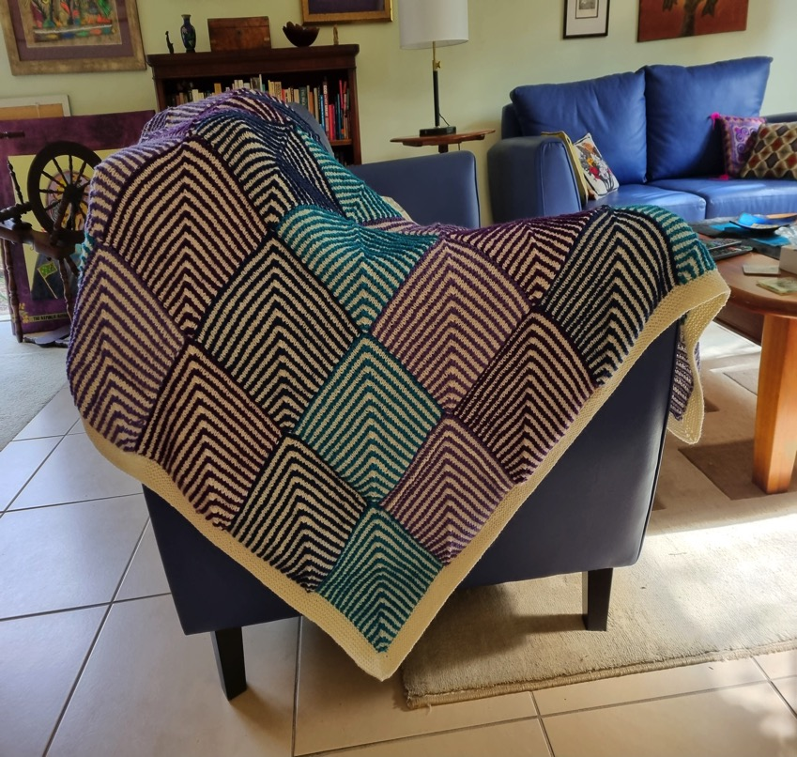
And Got Creative

Slide 20
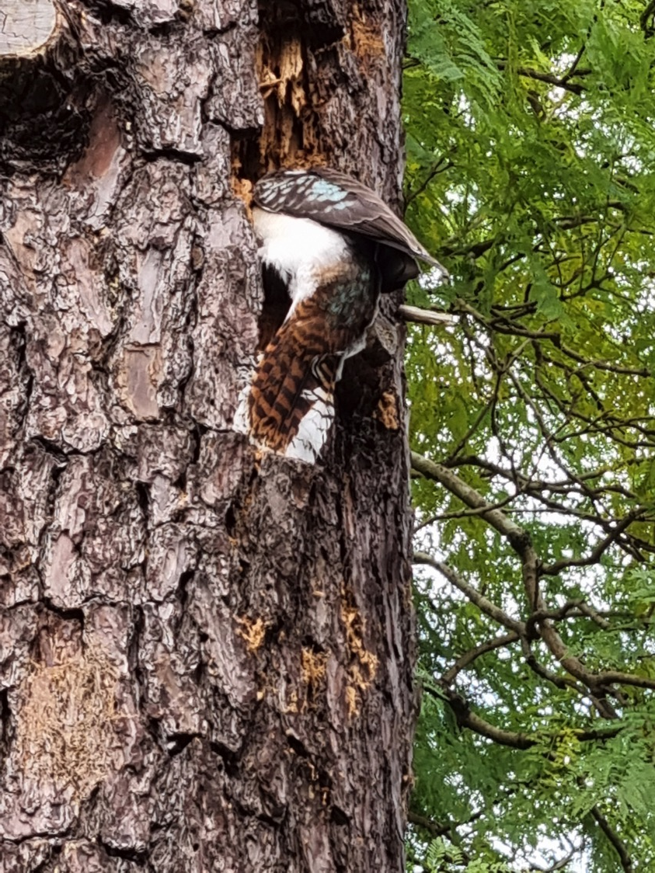
Kookaburras making a nest hollow in the dead pine tree next door

Slide 21
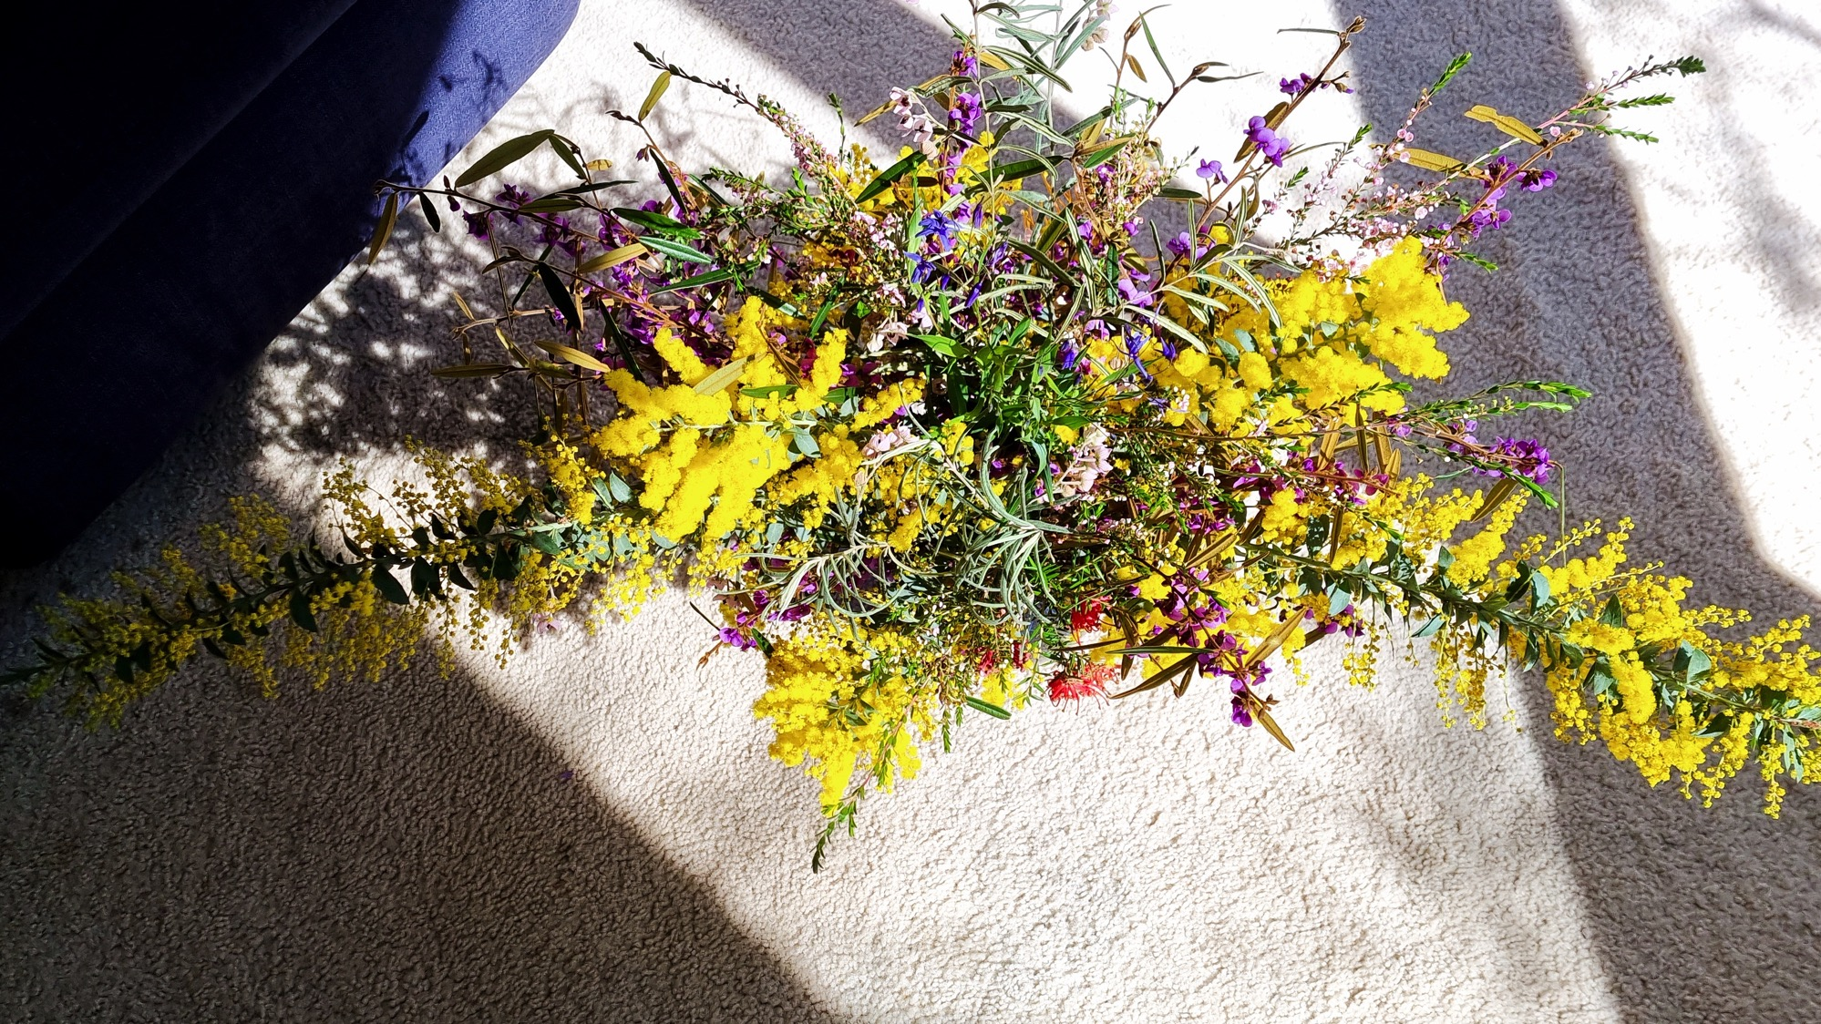

Slide 22
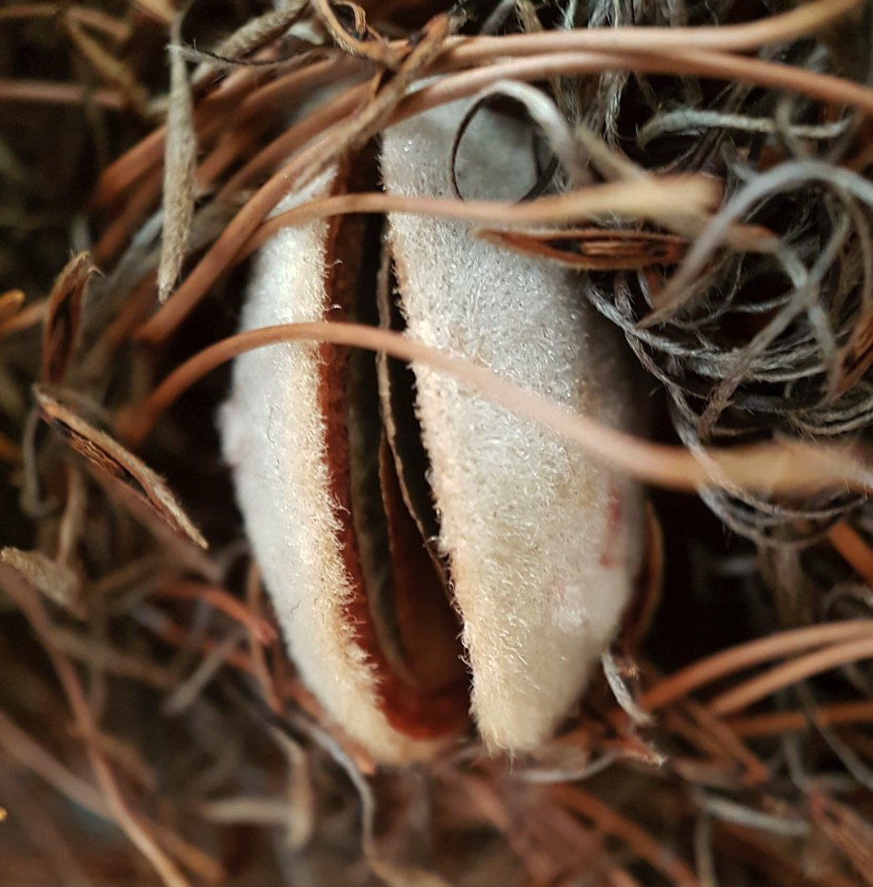
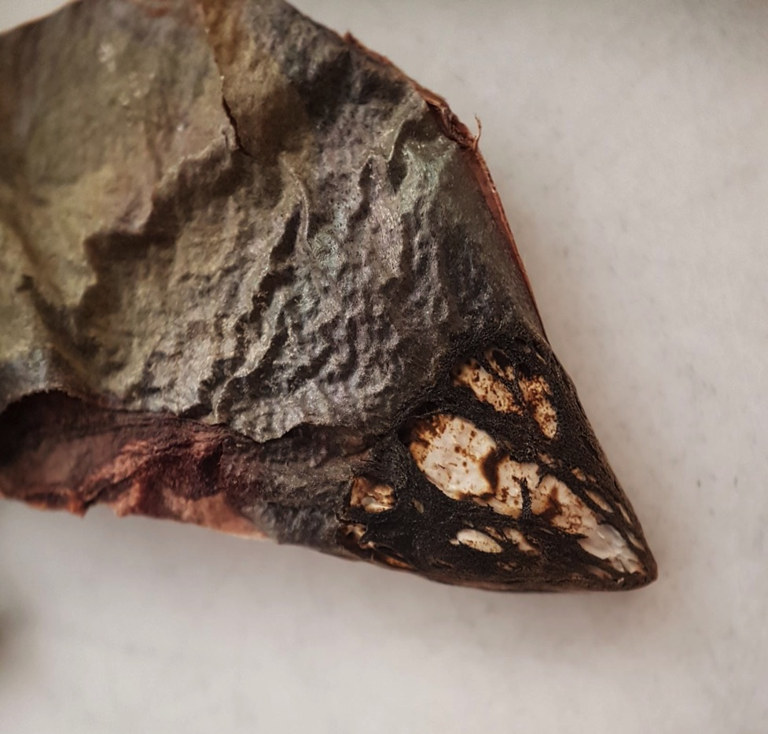
Rikki photographed the local bushland
Banksia valve and seed
Unformed Banksia seed

Slide 23
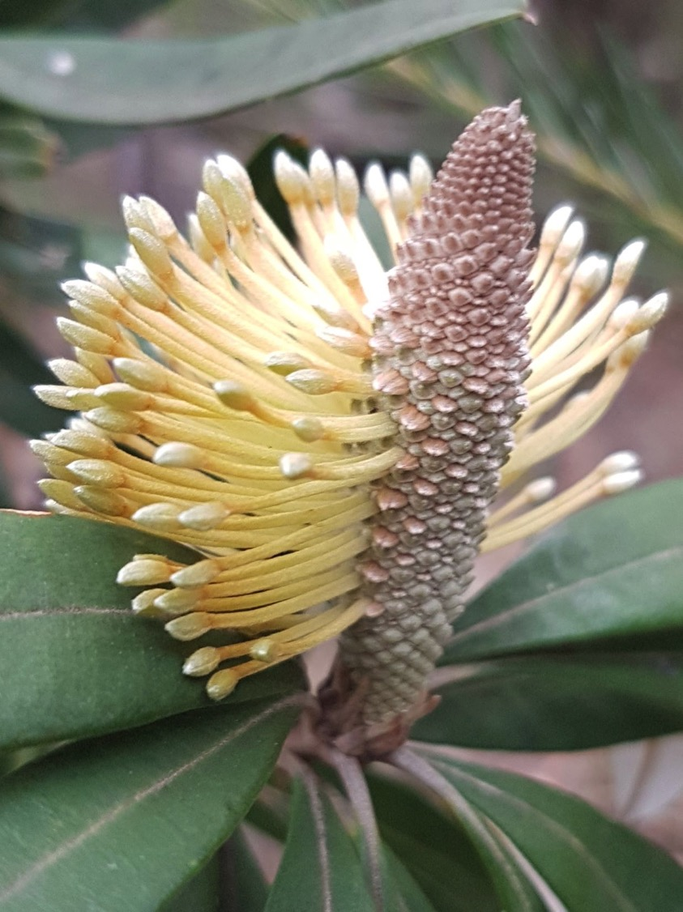
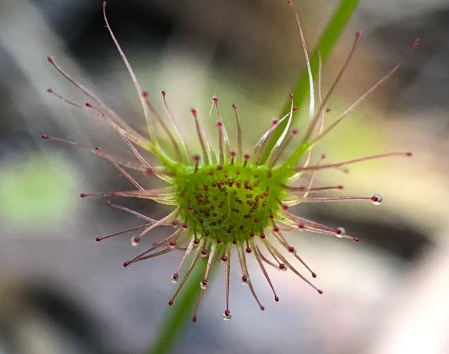
Banksia flower just forming
Drosera

Slide 24
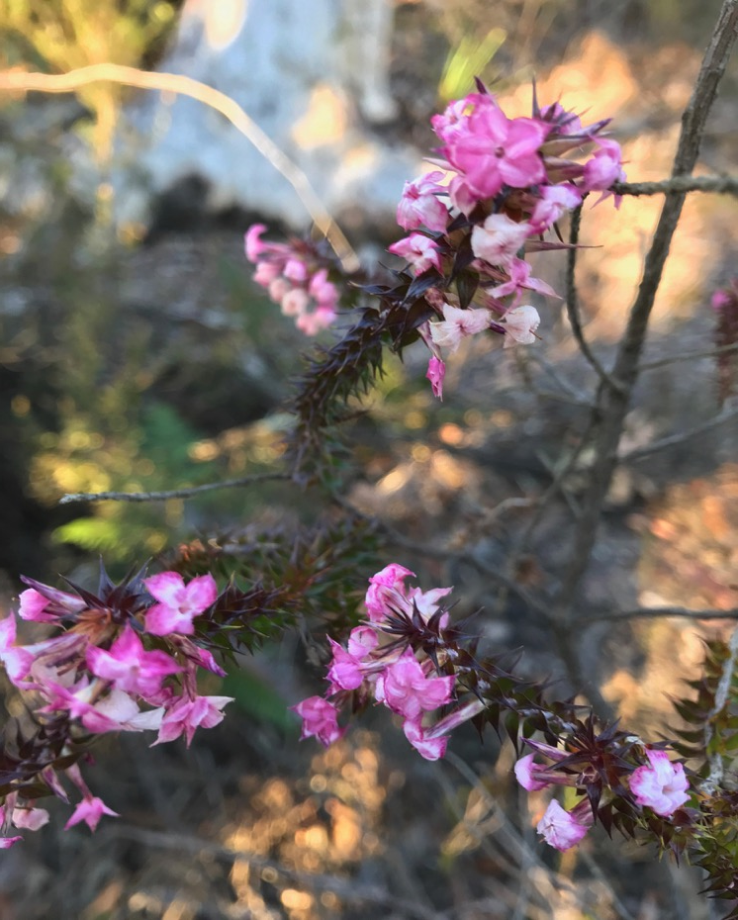
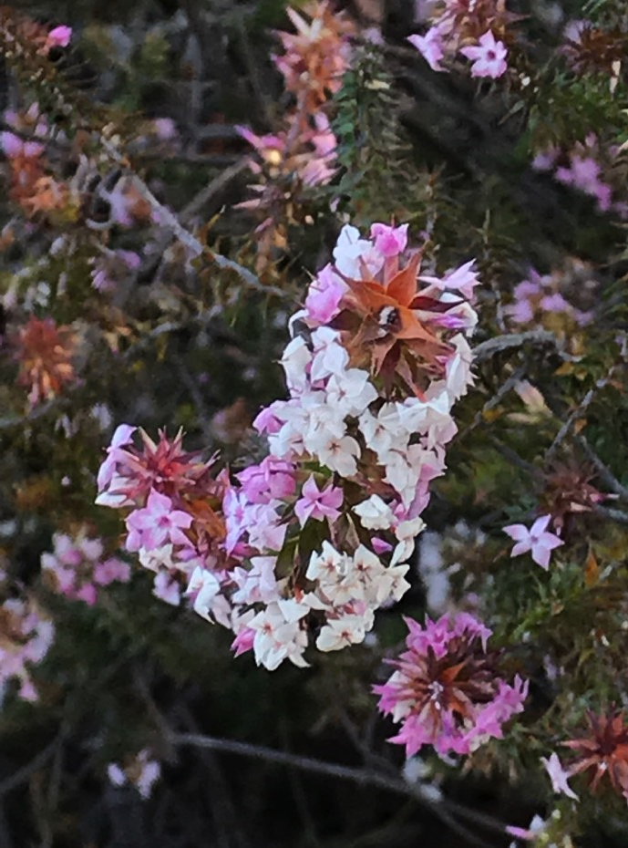
Lesley and Ian went walking
Woollsia pungens (pink form) at Lawson

Slide 25
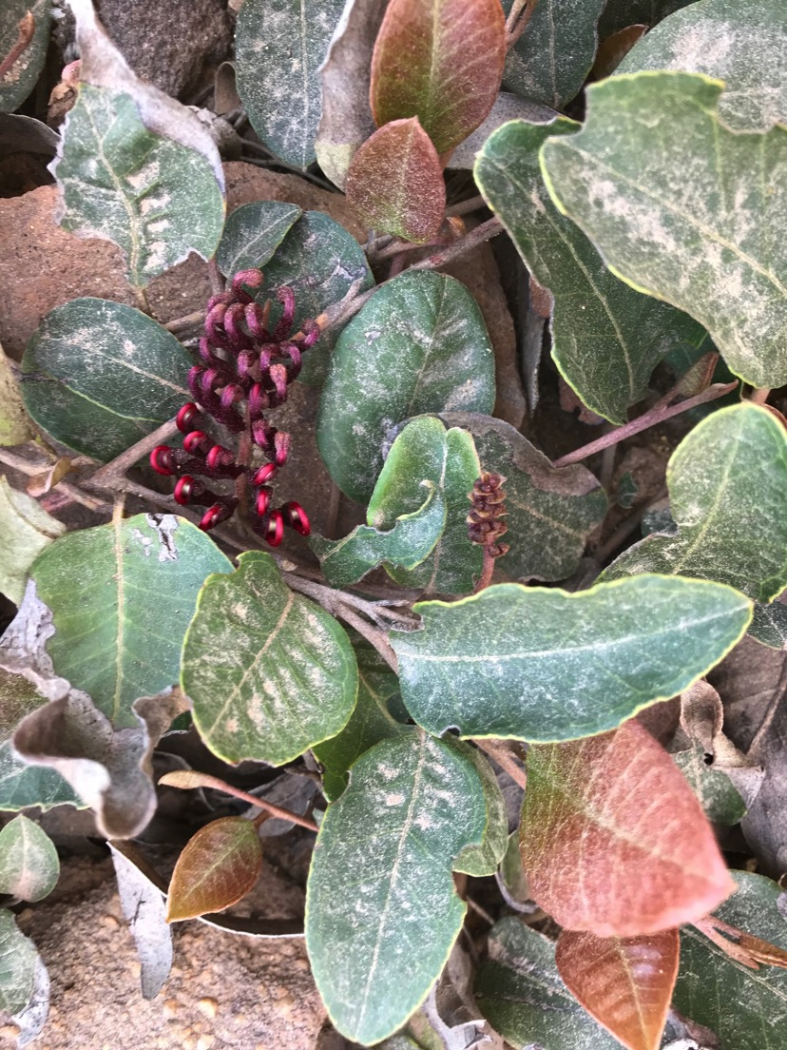
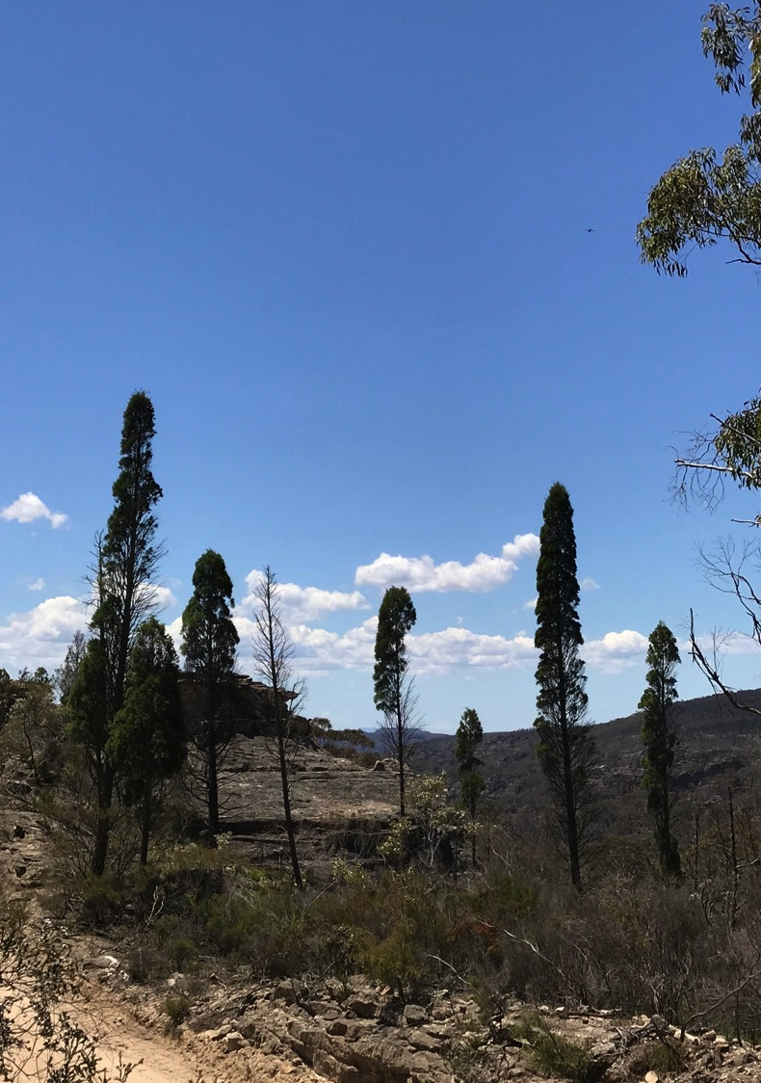
Grevillea laurifolia and Callitris
Newnes Plateau

Slide 26
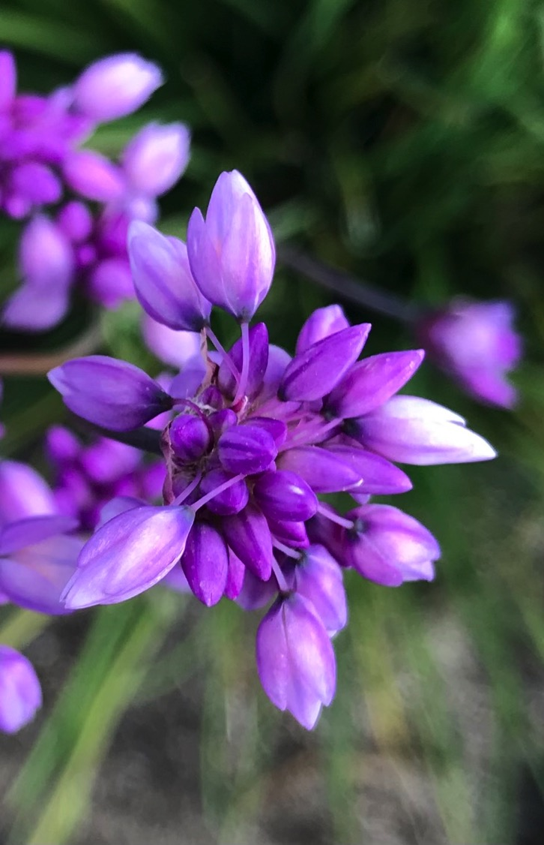
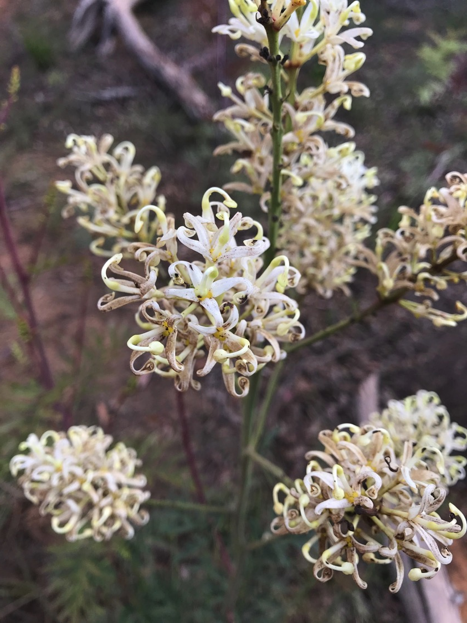
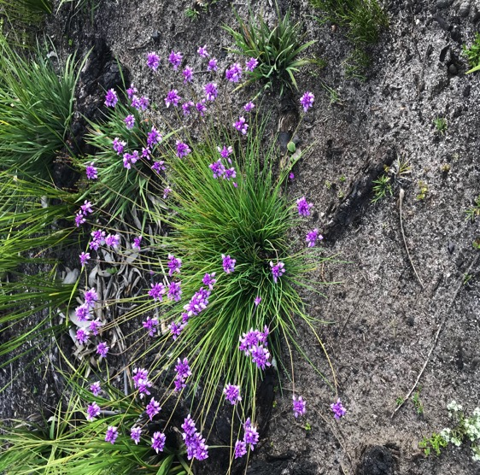
Lomatia silaifolia and Sowerbaea juncea
Gardens of Stone

Slide 27
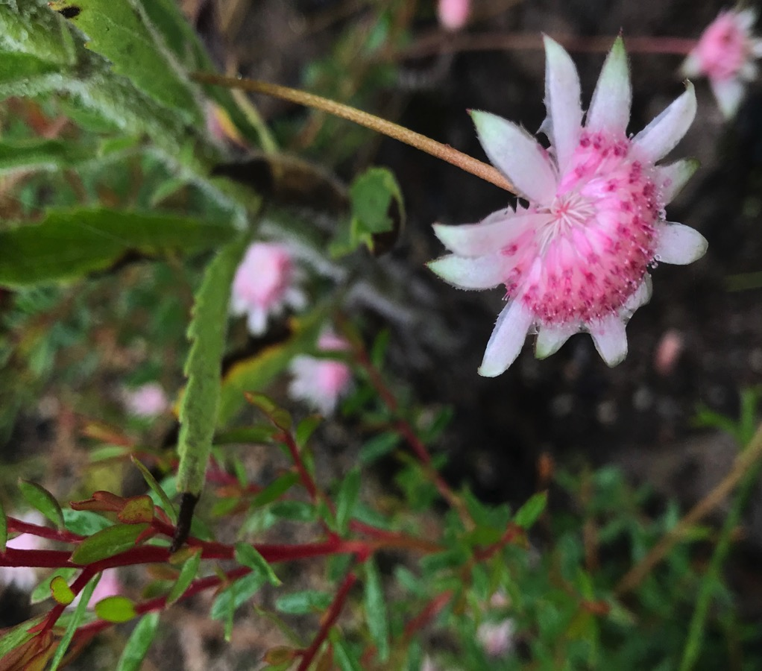
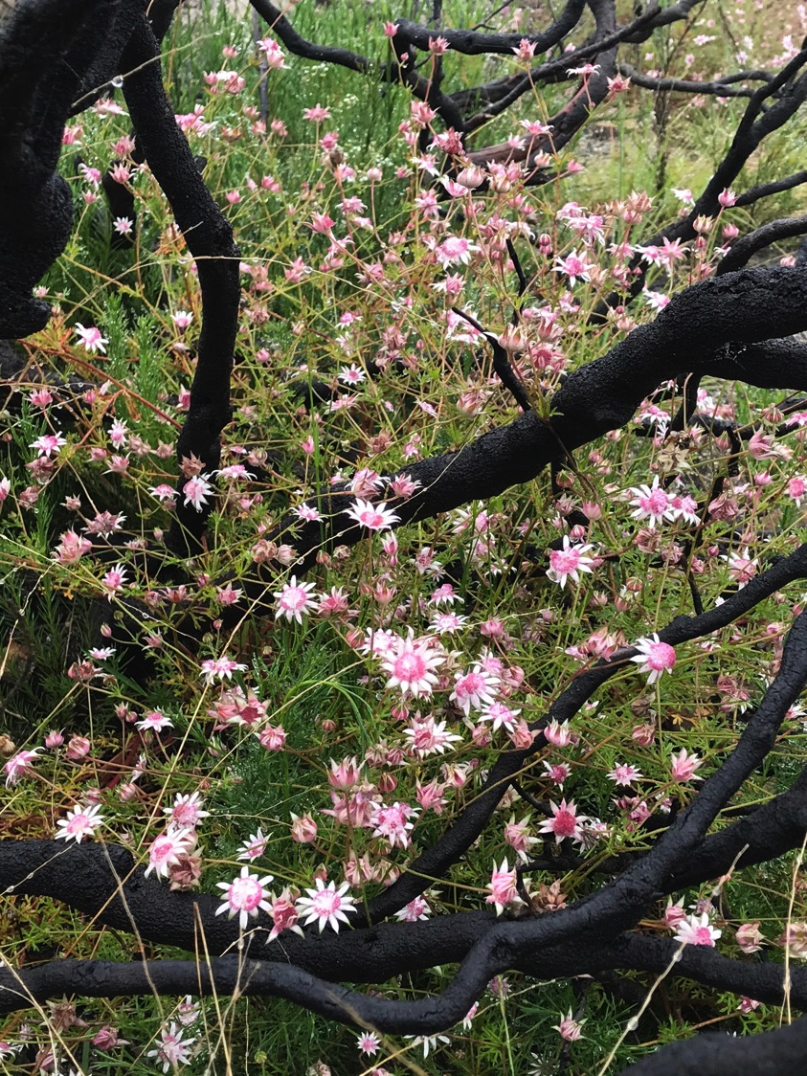
Actinotus forsythia at Narrowneck

Slide 28
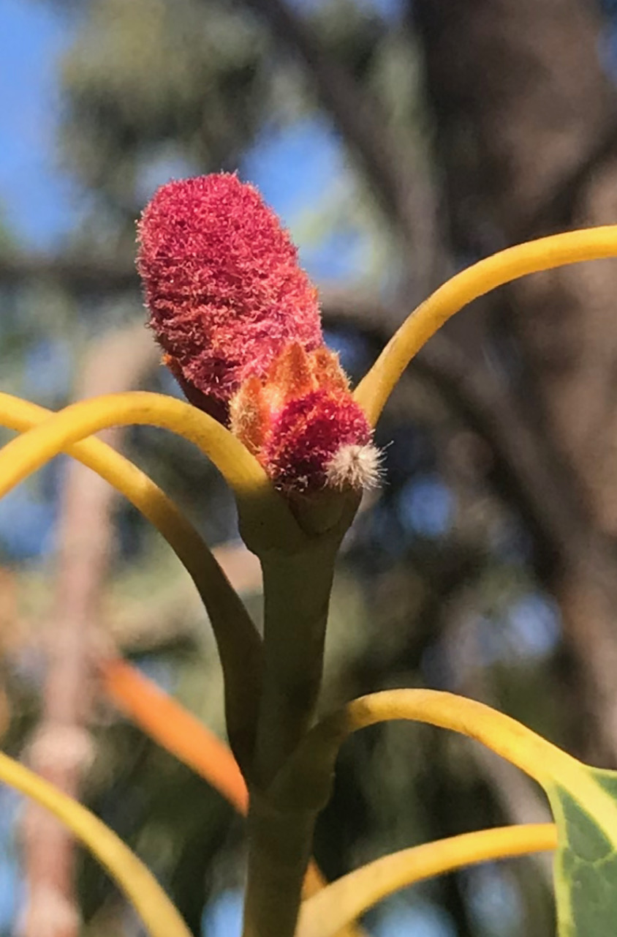
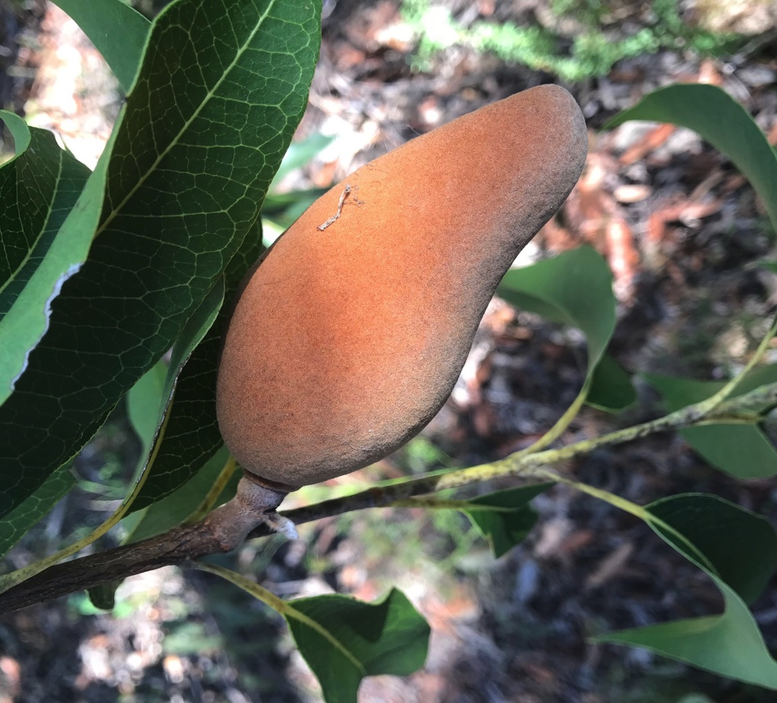
Woody Pear Xylomelum pyriforme

Slide 29
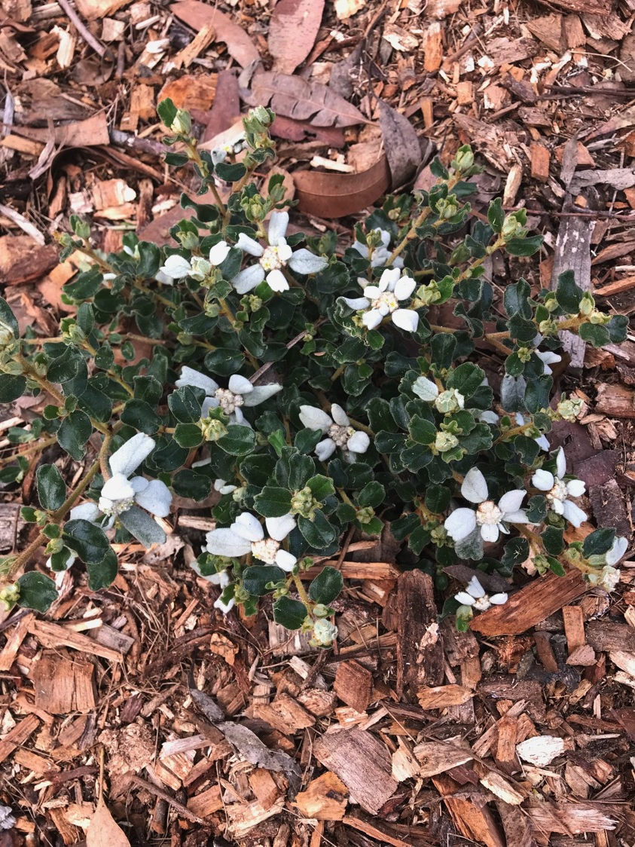
Spyridium coatifolium

Slide 30
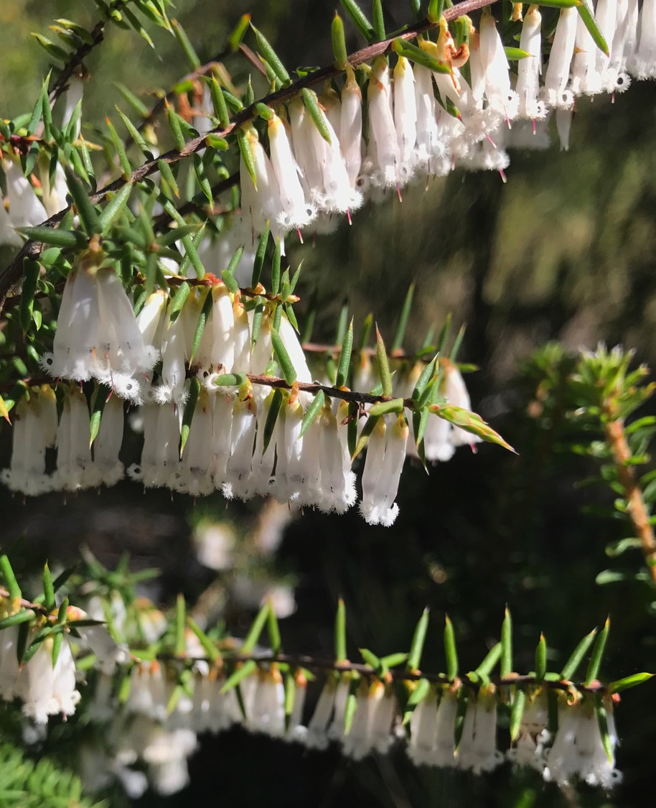
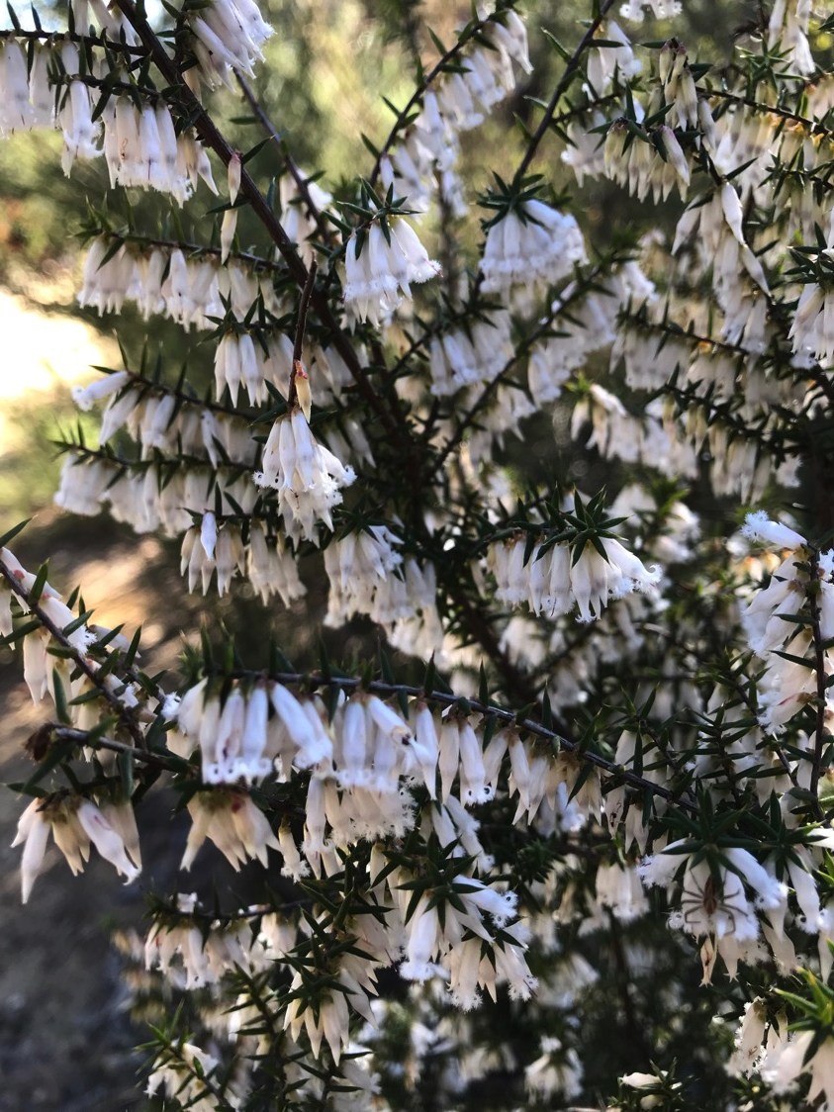
Leucopogon fletcheri
Jones Road
Kenthurst

Slide 31
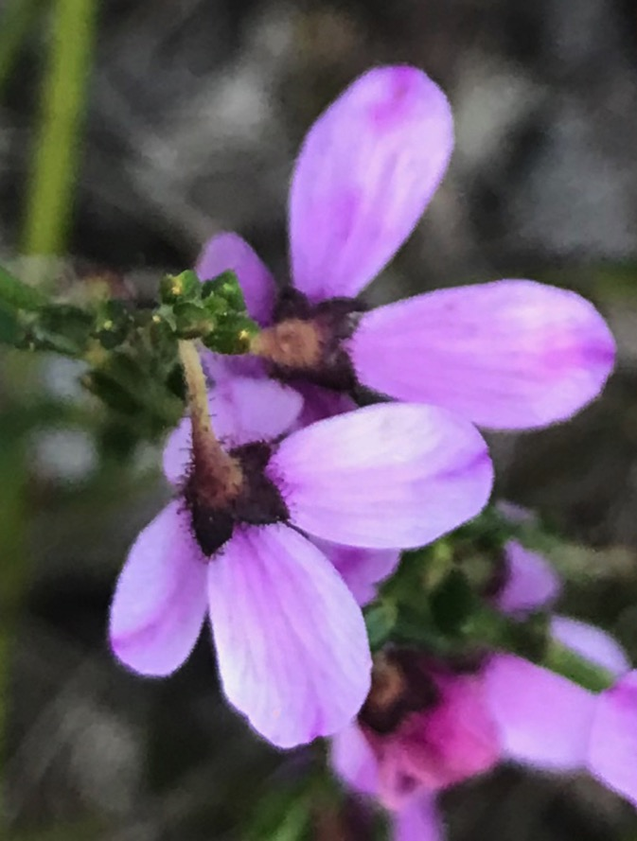
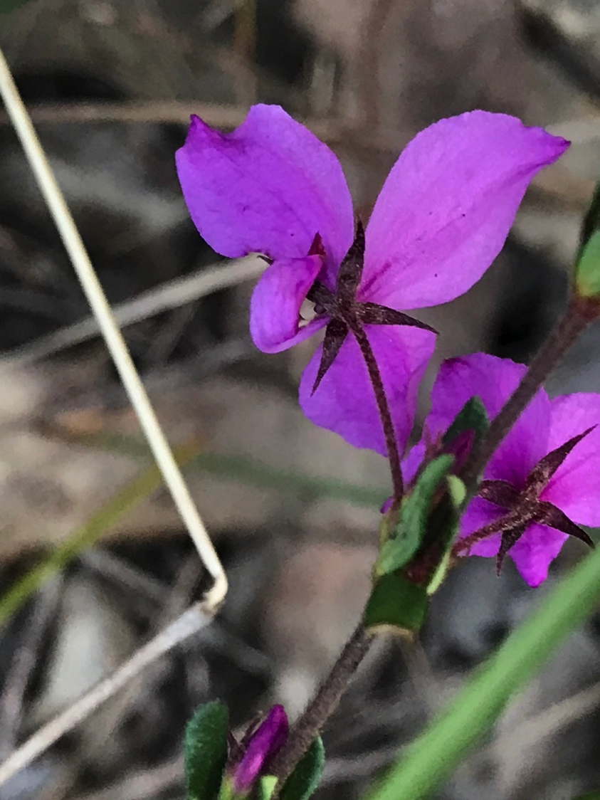
Tetratheca glandulosa above
Tetratheca thymifolia on right

Slide 32
Boronia floribunda
Jones Road Kenthurst

Slide 33
Philotheca salsolifolia Jones Road Kenthurst

